Slide 1
Klasifikasi Penyakit Padi dengan SVM
Mario Alfredo Bawu

Slide 2
Dataset
Dataset | total kelas | Bacterial leaf blight | blast | Brown spot | normal | tungro | Total
Deep Feature | 4 | 1326 | 960 | 1200 | 0 | 1308 | 1694
rice_leaves_disease | 4 | 180 | 305 | 267 | 157 | 0 | 909
Paddy_doctor_healthy | 1 | 0 | 0 | 0 | 1400 | 0 | 1400
Total | 5 | 1506 | 1265 | 1467 | 1557 | 1308 | 7103
Segment | Bacterial leaf blight | blast | Brown spot | normal | tungro | Total
Train+Validation | 1306 | 1065 | 1267 | 1357 | 1108 | 6103
Test | 200 | 200 | 200 | 200 | 200 | 1000
Total | 1506 | 1265 | 1467 | 1557 | 1308 | 7103

Slide 3
Dataset

Slide 4
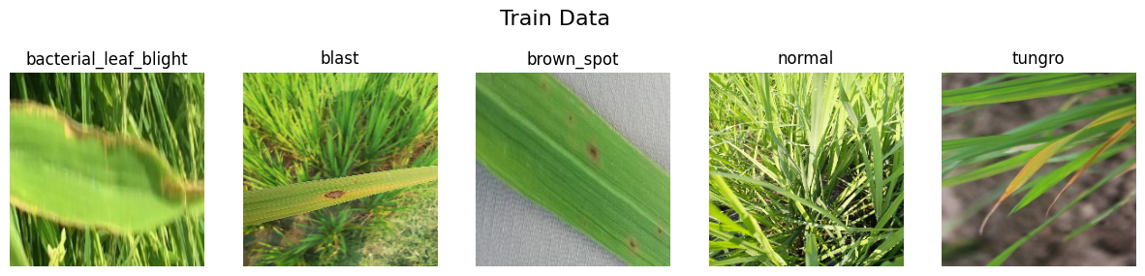
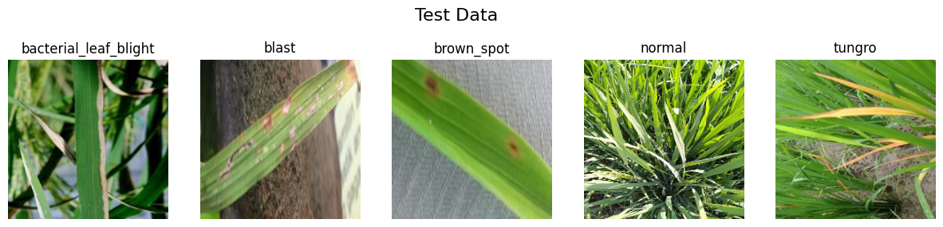
Dataset

Slide 5
Augmentasi
Data | bacterial leaf blight | blast | brown spot | normal | tungro | Total
Real | 1306 | 1065 | 1267 | 1357 | 1108 | 6103
Augmented | 3694 | 3935 | 3733 | 3643 | 3892 | 18897
Total | 5000 | 5000 | 5000 | 5000 | 5000 | 25000

Slide 6
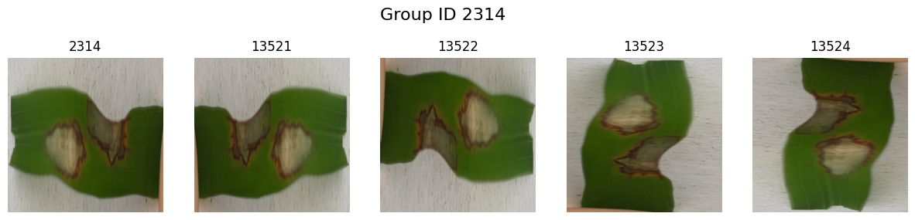
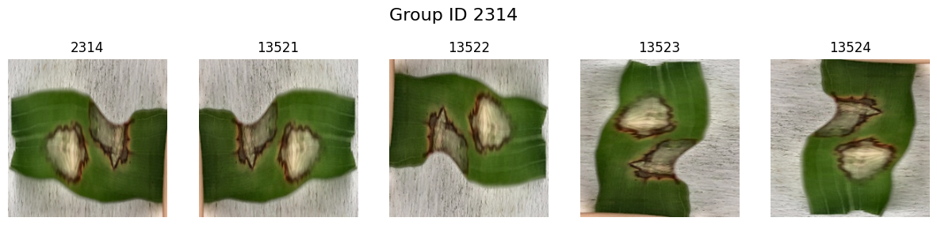
Normalisasi

Slide 7
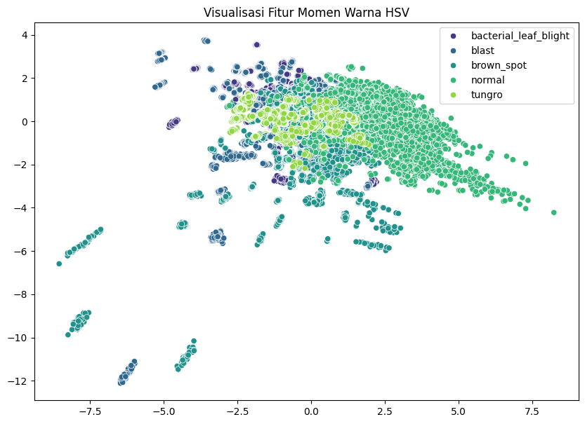
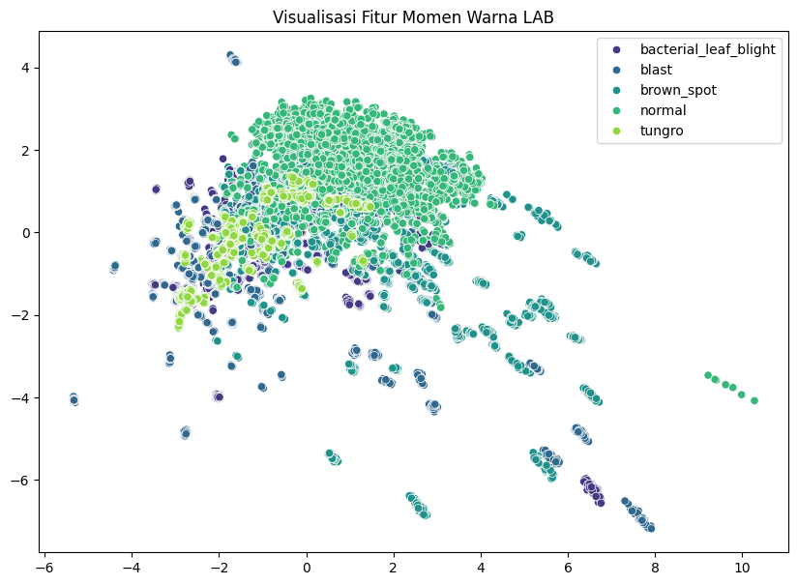
Ekstraksi Fitur

Slide 8
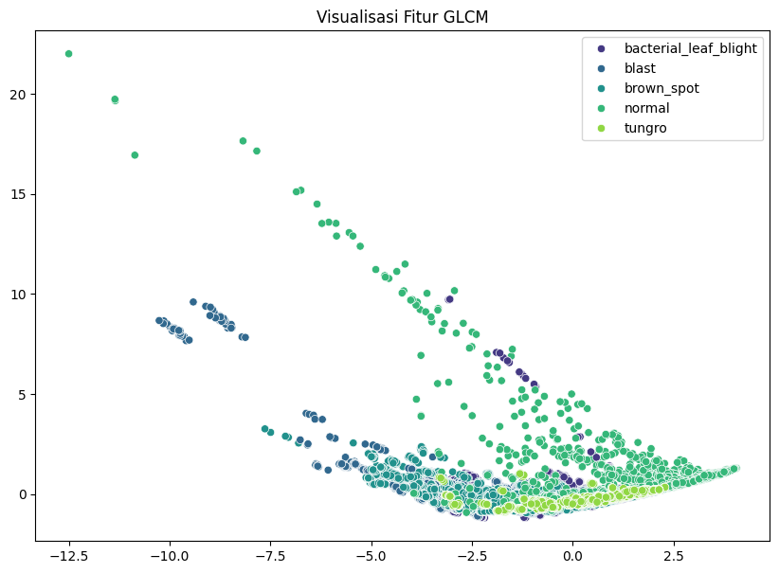
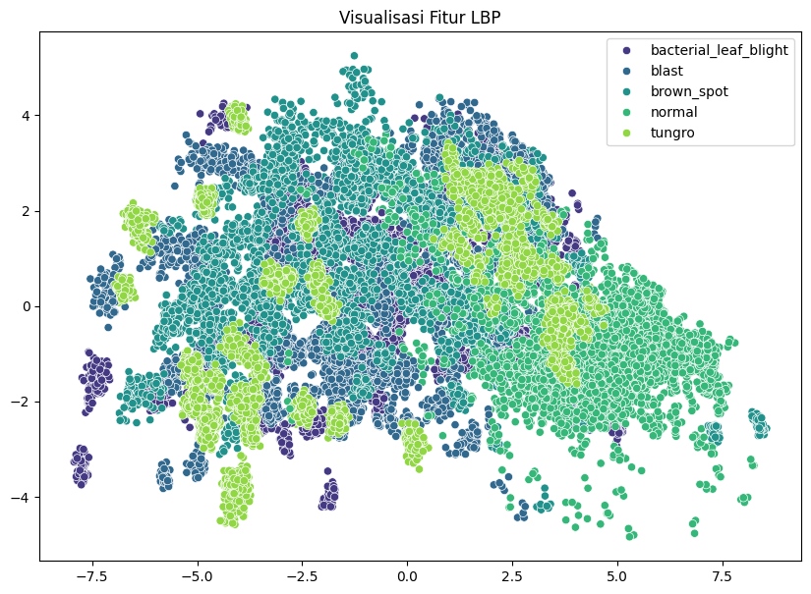
Ekstraksi Fitur

Slide 9
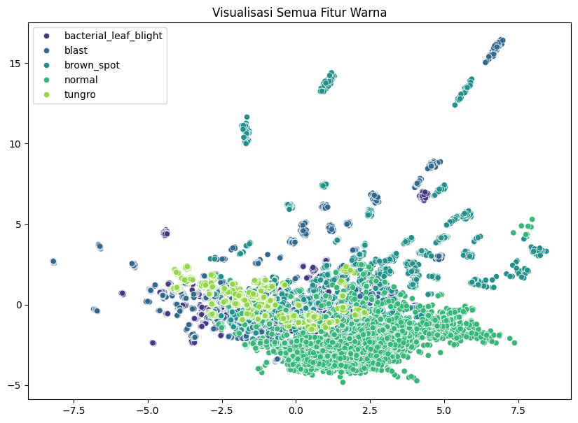
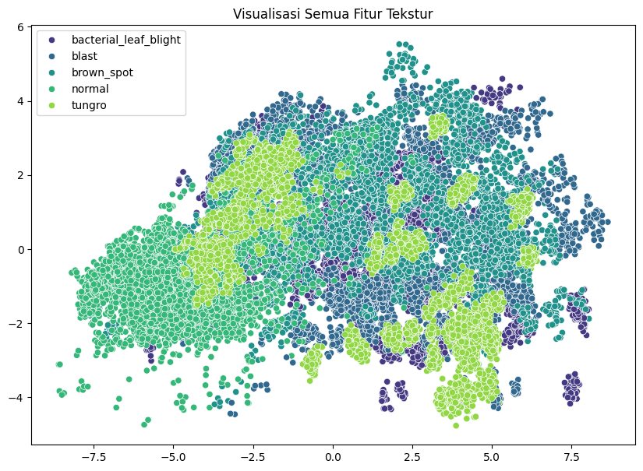
Ekstraksi Fitur

Slide 10
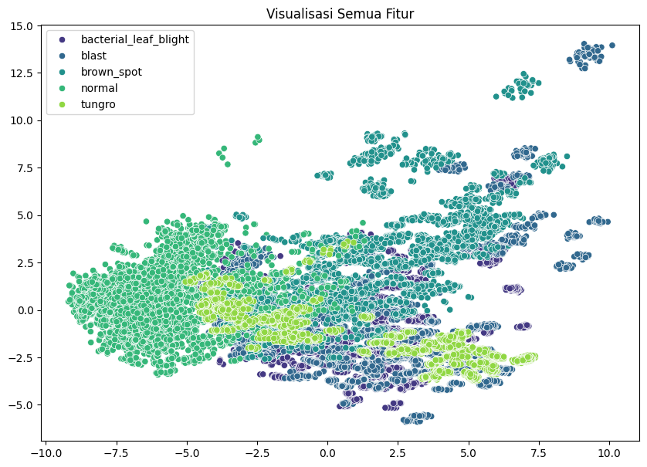
Ekstraksi Fitur

Slide 11
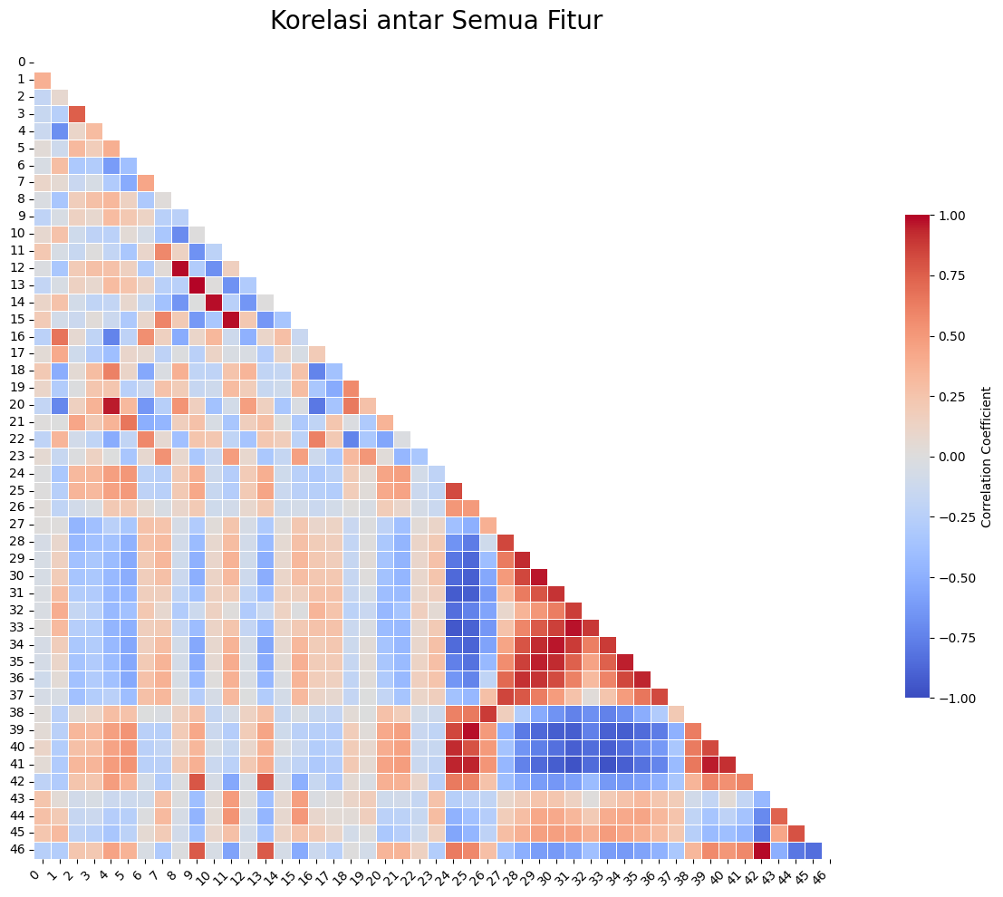
Ekstraksi Fitur

Slide 12
Pipeline Model & Grid Search Params
StandardSacler
PCA
SVM
PCA n components : 0.95, 0.90
SVC C : 0.1, 1, 10, 100
SVC gamma : 0.001, 0.01, 0.1, 1
SVC kernel : RBF
StratifiedGroupKFold: 5, Shuffled

Slide 13
Grid Search Result
Feature | mean fit time (second) | PCA n components | svc C | svc gamma | mean test accuracy | mean test precision macro | mean test recall macro | mean test f1 macro | size (KB)
Momen warna HSV | 5,0920 | 0,95 | 1,0 | 1,0 | 98,17% | 98,18% | 98,17% | 98,17% | 239
Momen warna LAB | 4,2990 | 0,95 | 1,0 | 1,0 | 98,24% | 98,26% | 98,24% | 98,24% | 235
LBP | 5,5442 | 0,95 | 100,0 | 1,0 | 91,92% | 91,98% | 91,92% | 91,92% | 220
GLCM | 23,2710 | 0,95 | 100,0 | 1,0 | 74,78% | 75,84% | 74,78% | 74,79% | 459
Warna | 5,6523 | 0,95 | 1,0 | 1,0 | 98,35% | 98,37% | 98,35% | 98,35% | 414
Tekstur | 4,7463 | 0,95 | 10,0 | 1,0 | 95,88% | 95,91% | 95,88% | 95,88% | 343
Semua | 2,8839 | 0,95 | 100,0 | 0,1 | 98,34% | 98,35% | 98,34% | 98,35% | 342

Slide 14
Grid Search Result

Slide 15
Pipeline Model & Grid Search Params (2)
StandardSacler
PCA
SVM
PCA n components : 0.95
SVC C : 10, 25, 50, 100
SVC gamma : 0.1, 1
SVC kernel : RBF
StratifiedGroupKFold: 5, Shuffled

Slide 16
Grid Search Result (2)
mean test f1 macro rank | mean_fit_time (second) | svc C | svc gamma | mean test accuracy | mean test precision macro | mean test recall macro | mean test f1 macro
1 | 2,910029 | 50 | 0,1 | 98,42% | 98,42% | 98,42% | 98,42%
2 | 2,730338 | 25 | 0,1 | 98,41% | 98,42% | 98,41% | 98,41%
3 | 2,594676 | 100 | 0,1 | 98,34% | 98,35% | 98,34% | 98,35%
4 | 2,920487 | 10 | 0,1 | 98,33% | 98,34% | 98,33% | 98,33%
5 | 15,511428 | 25 | 1,0 | 97,54% | 97,69% | 97,54% | 97,56%

Slide 17
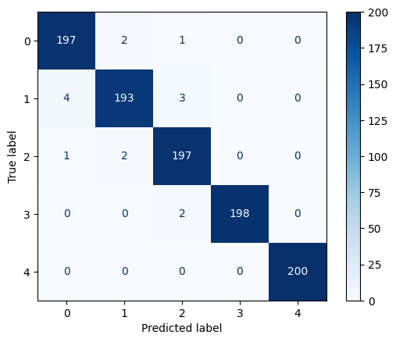
Pengujian Model
 | precision | recall | f1-score | support
bacterial_leaf_blight | 0,9752 | 0,985 | 0,9801 | 200
blast | 0,9797 | 0,965 | 0,9723 | 200
brown_spot | 0,9704 | 0,985 | 0,9777 | 200
normal | 1 | 0,99 | 0,995 | 200
tungro | 1 | 1 | 1 | 200
accuracy |  |  | 0,985 | 1000
macro avg | 0,9851 | 0,985 | 0,985 | 1000
weighted avg | 0,9851 | 0,985 | 0,985 | 1000

Slide 18
Hasil Demo Data Lokal
Total Waktu Keseluruhan: 11.9116 detik
Total Gambar Dites: 67
Durasi Rata-rata per Gambar:
Memuat Gambar: 0.093659 detik
Ekstraksi Fitur: 0.080897 detik
Prediksi Model: 0.003155 detik

Slide 19
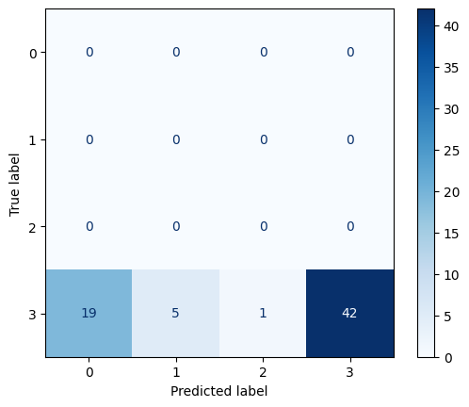
Hasil Demo Data Lokal
 | precision | recall | f1-score | support
bacterial_leaf_blight | 0 | 0 | 0 | 0
blast | 0 | 0 | 0 | 0
brown_spot | 0 | 0 | 0 | 0
normal | 1 | 0,6269 | 0,995 | 67
tungro | 0 | 0 | 0 | 0
accuracy |  |  | 0,6269 | 1000
macro avg | 0,25 | 0,1567 | 0,1927 | 1000
weighted avg | 1,00 | 0,6269 | 0,7706 | 1000

